Slide 1
IBM COGNOS ANALYTICS
HOTEL MANAGEMENT

Slide 2
Hotel managements
INTRODUCTION:
In this project we are going to analyze the hotel management data using IBM COGNOS Analytics tool.
Using COGNOS tool, we analyzed the data with its toolbox like List, Text Item, Block, Table, Crosstab and Visualization.

Slide 3
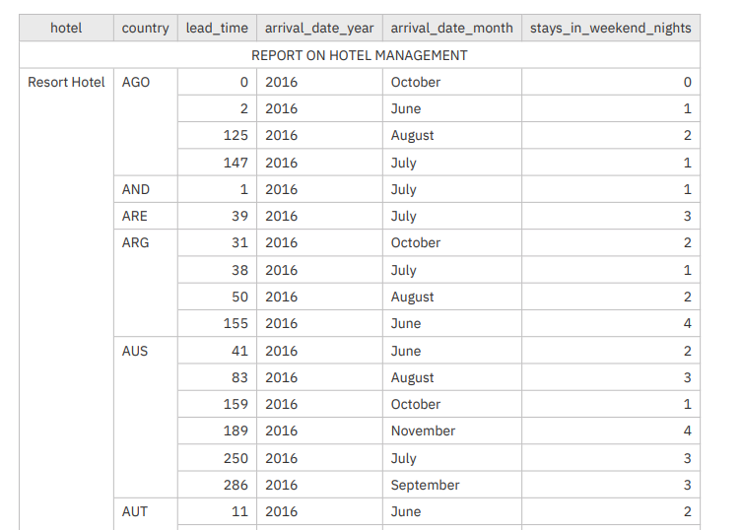
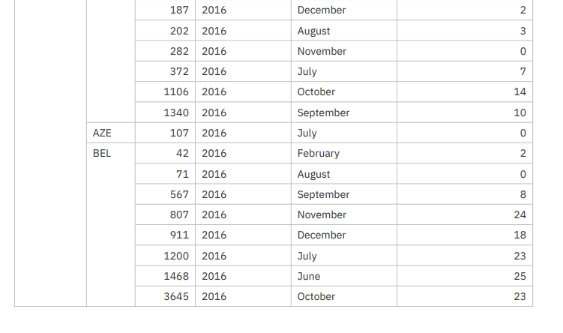
REPORT
HOTEL DATABASE AS LIST

Slide 4
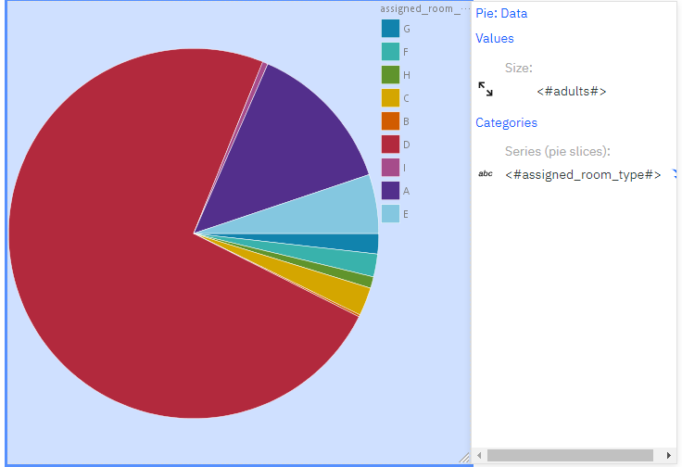
2. NO. OF ADULT AS ROOM TYPE

Slide 5
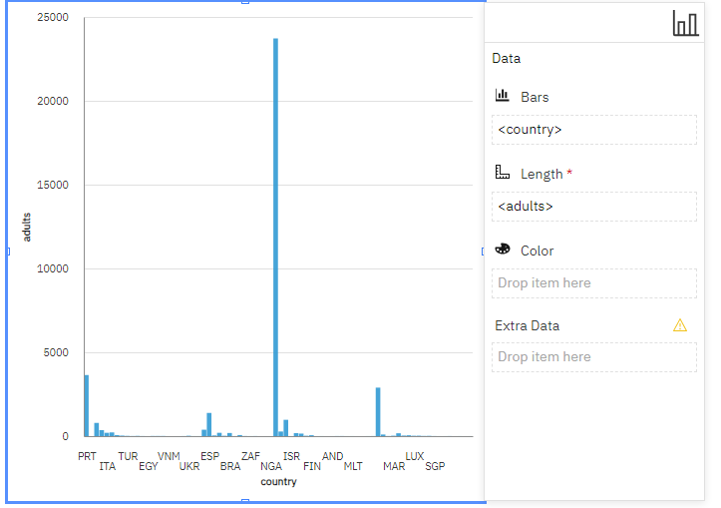
3. NO. OF ADULTS CAME TO HOTEL AS COUNTRY WISE

Slide 6
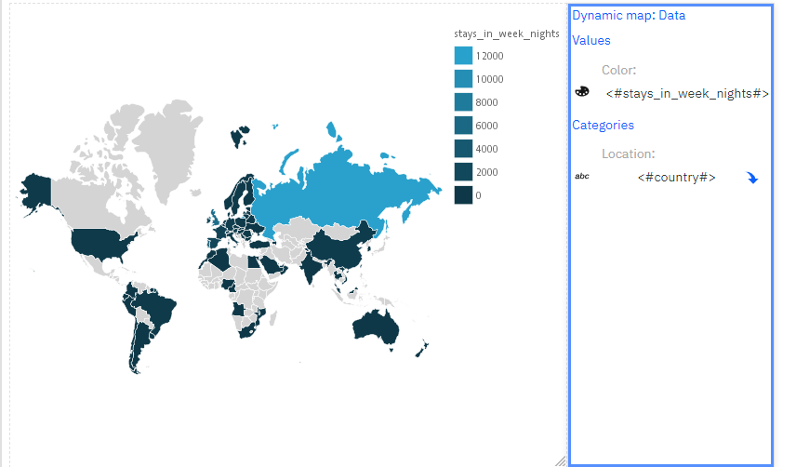
4. NO. OF. PERSON STAYS IN WEEK NIGHTS AS COUNTRY WISE

Slide 7
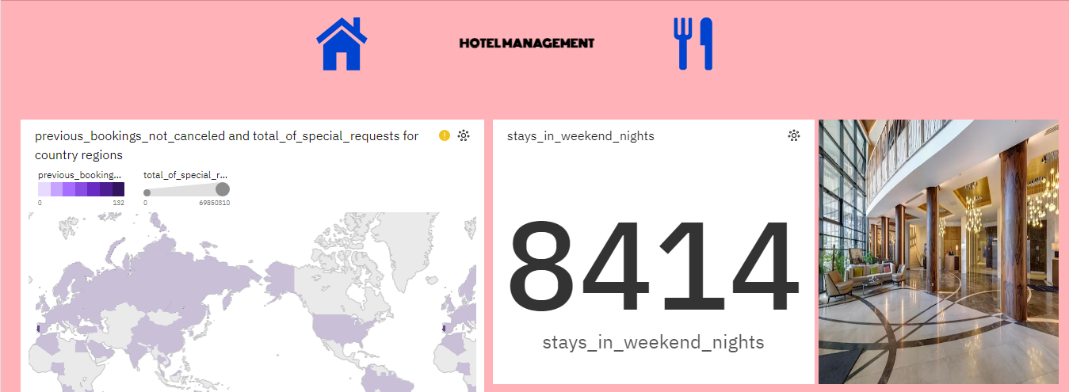
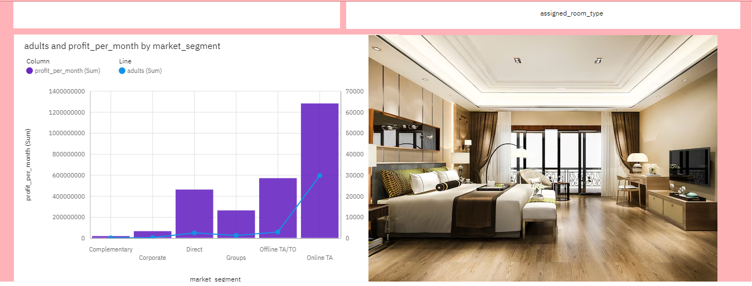
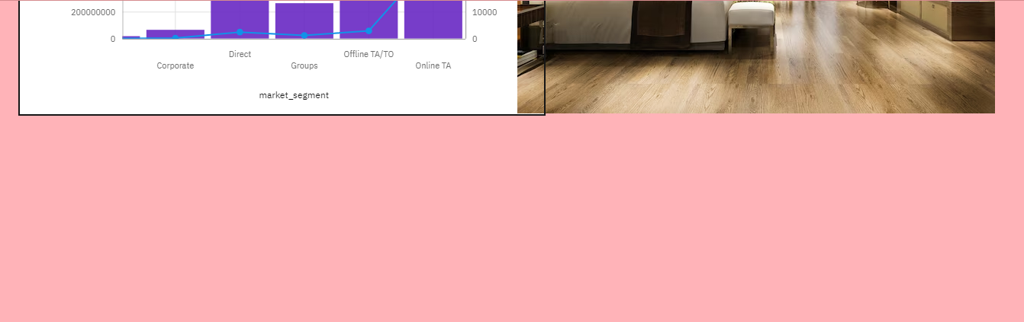
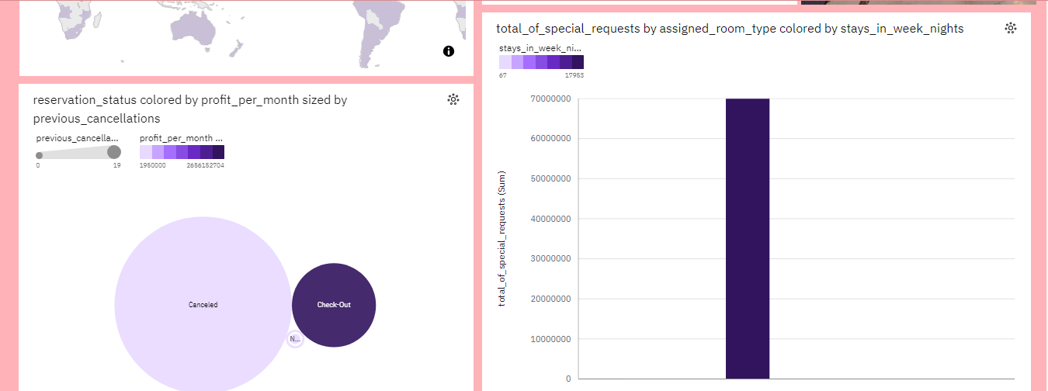
FINAL DASH BOARD

Slide 8
THANK YOU

